Slide 1
Real-time myocontrol of paretic muscles using machine learning
Mathews Joseph
class no:36, s7R
Dept. of CSE, MACE Kothamangalam
8/10/2018

Slide 2
Introduction
What is stroke?
Possibility of signal acquisition.
Faster rehabilitation.
Social relevance.

Slide 3
Existing methods
Single Degree Of Freedom.
Torque ratio using amplitude of signals.
single muscle signals, not as a synergy
Limitations in simulations.

Slide 4
Existing methods(Contd..)
Noise level control.
Need for partial movement.
Usage of non-surface electrodes.
Degrading results with increased severity.

Slide 5
Using machine learning
Muscles are considered as a group.
Synergy analysis.
Complex movements are possible.
Opportunity for direct sensing for the patients.
Possibility of better simulations and games.

Slide 6
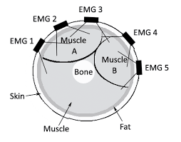
Implementation
sEMG electrodes.
Arm bands.
Amplification and
Filtering(20-2000Hz).
Fig 1.EMG electrodes on arm(courtesy:google images)

Slide 7
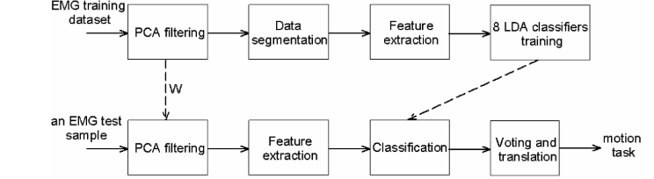
Implementation(Contd..)
Fig 2 .Working process
(courtesy:Real-time myocontrol of human computer interface by paretic muscles after stroke,Chung Yang,M.A Urbin 2018)

Slide 8
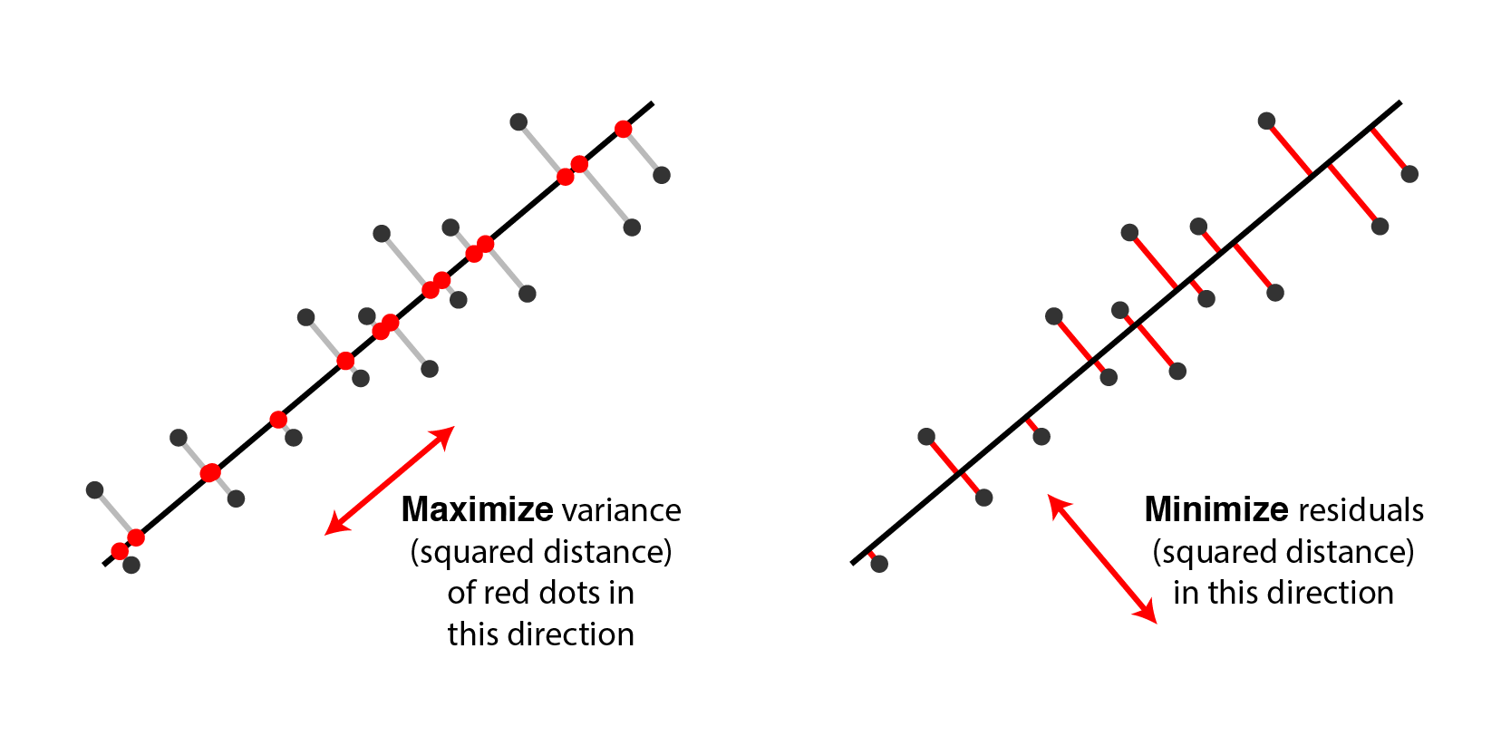
Principal component analysis
PCA-dimensionality reduction while preserving variance.
Independent features
Fig 3.PCA
(Courtesy:http://alexhwilliams.info)

Slide 9
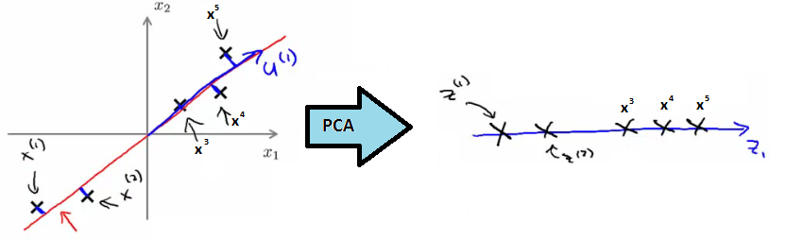
Principal component analysis
Newly extracted components, independent of each other.
The feature with most contribution becomes pc1.
Fig 4.Simple implementation of PCA
(Courtesy:https://www.dezyre.com)

Slide 10
Principal component analysis
2 main components contributed to 90% of total variance.
Activations of 8 muscles were made into a 2D representation
S = W^{T} Y
W -> 8*2matrix (pca1,pca2)
Y ->8*n matrix
This is the pattern for each gesture as a synergy .

Slide 11
Feature extraction
Data is segmented as samples with 250ms,50ms overlap.
Time domain features were extracted from each of these
Mean abs ,slope sign change, zero crossing, waveform length
These 4 features can be used for model training.

Slide 12
Linear Discriminant Analysis
Maximize separation between the mean of each class
Minimize the spreading within the class .
Works even as a dimensionality reducer.

Slide 13
Linear Discriminant Analysis
Classification algorithm.
Finds common properties and uses it for classification.
8 LDA classifiers trained using 1 vs. rest method.
8 sets of score for any sample .

Slide 14
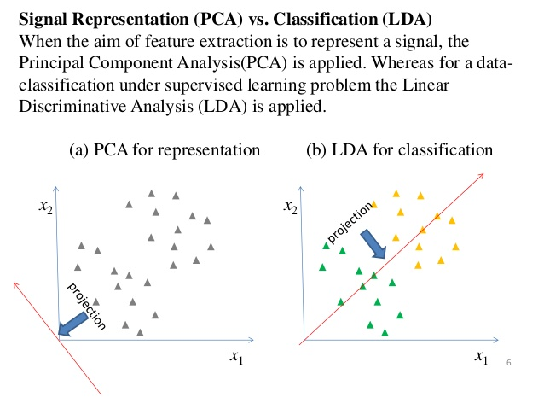
LDA and PCA
Fig 5.LDA vs PCA
(Courtesy: Google Images)

Slide 15
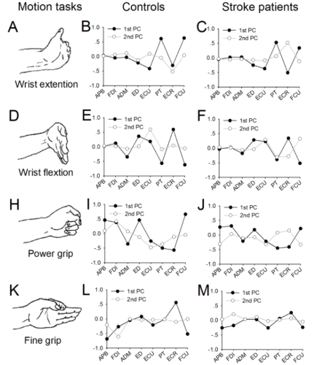
Results
Fig 6.Results
(courtesy:Real-time myocontrol of human computer interface by paretic muscles after stroke,Chung Yang,M.A Urbin 2018)

Slide 16
Results(Contd..)
Stroke subjects -78% accuracy, controls -90%.
Average game completion time for controls- 30.5s ,subjects-33.3s.
Similarity in patterns

Slide 17
Advantages
Realization of complex motions of human hand.
Faster Rehabilitation through better muscle training.
Mechanical aids for support.
Endless possibilities of human computer interaction for the patients.

Slide 18
Disadvantages
Requirement of hardware on the patient.
The data acquisition devices are expensive.
Need for fast and real-time computing.
Not applicable on patients with no emg signals on muscles.

Slide 19
conclusion
Effectiveness .
Accuracy.
Suitability for patients.
Painless.

Slide 20
Conclusion(Contd..)
Easier rehabilitation.
Possibility of robotic aids.
Possibilities for virtual interaction.

Slide 21
References
N Barret ,I Swain ,C Gatzidis “the use and effect of video game design theory in creation of game based systems for upper limb rehabilitation” –Journal of Rehabilitation and Assistive technologies Engineering 2016
Z Lu, X Chen,Q Li,X Zhang “hand gesture recognition framework and wearable gesture based interaction” –IEEE transactions on human machine systems
“Principal Component Analysis”-Ian Jolliffee Wiley Online Library 2002

Slide 22
References
Thalamic labs 2013,MYO-Gesture control armband by Thalamic labs
E.L Allwein, R E Schapire Y.Singer “Reducing multiclass to Binary”:A unifying approach 2001
P.K Artemiadis and K.J Kyriakopoulos “EMG based control of robotic arm using low-dimensional Embeddings

Slide 23
References
M. Ison, P. Artemiadis, "The role of muscle synergies inmyoelectric control: trends and challenges for simultaneousmultifunction control," J Neural Engg, vol. 11, 051001, 2014.
A. J. Young, L. H. Smith, E. J. Rouse, and L. J. Hargrove,"Classification of simultaneous movements using surface EMGpattern recognition," IEEE Transactions on BiomedicalEngineering, vol. 60, pp. 1250-1258, 2013.

Slide 24
Thank you

